Slide 1
Computer Security Costs Management
Lecture 10

Slide 2
Contents
1. The main factors of financial losses due to security breaches
2. Factors influencing the level of loss caused by the security incidents
3. Trends in the cost components of a data breach
4. Detection and responding to security incidents
5. Preventive measures to manage security incidents
6. Direct and indirect costs
7. Expenses related to detection of security incidents, response, mitigation and recovery

Slide 3
The main factors of financial losses due to security breaches
Financial:
a) decrease in sales, loss of orders or contracts
b) loss of assets
c) penalties/legal obligations
d) decrease in stock price
Operational:
a) loss of control
b) decrease of competitiveness
c) delay in the development
d) violation of standards
Customer related:
a) delayed deliveries to customers or partners
b) loss of clients or partners
c) loss of trust
d) damage to reputation
Related to the staff:
a) reducing motivation and productivity of staff
b) injury or death

Slide 4
The main factors of financial losses due to security breaches
Customer related:
a) delayed deliveries to customers or partners
b) loss of clients or partners
c) loss of trust
d) damage to reputation
Related to the staff:
a) reducing motivation and productivity of staff
b) injury or death

Slide 5
Points made in favour of information security expenditure include:
Security represents a cost of doing business
Security is akin to insurance costs
New e-business revenue streams may depend on proper security
Security is one aspect of risk management
Legal actions might result from failure to meet a general duty of care manifest as minimum security standards
Security costs are reduced over time

Slide 6
Factors influencing the level of loss caused by the security incidents

Slide 7
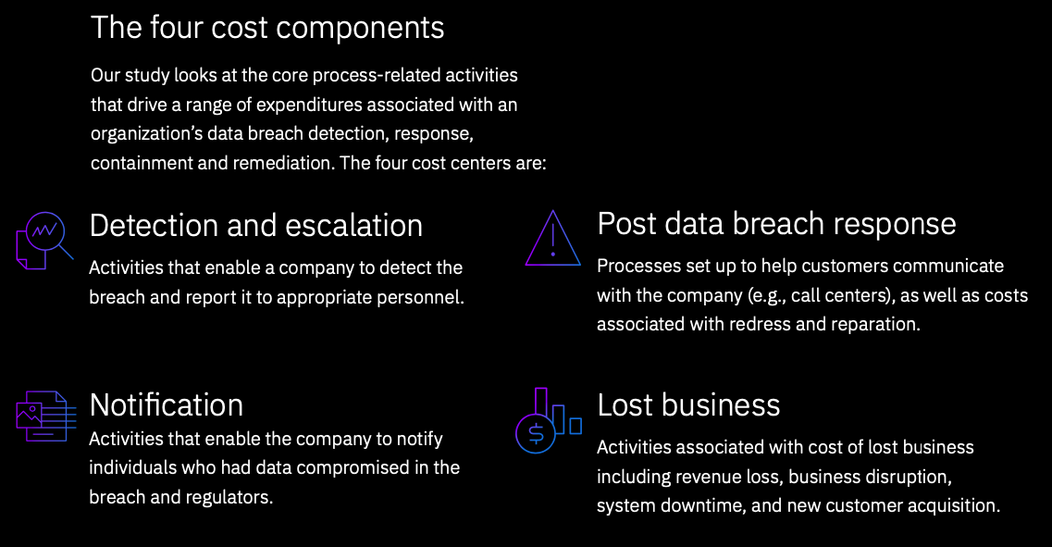

Slide 8
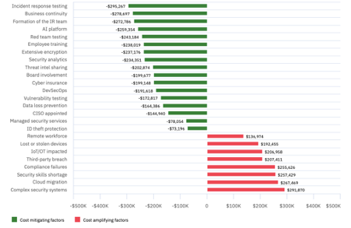

Slide 9
Outcomes of security incidents
• revenue lost from e-commerce sites brought down for a time;
• lost custom and good will from clients adversely affected;
• overtime paid to IT staff and additional contractors working to bring systems back on line;
• consulting fees paid to external specialists assisting with data recovery, repairs, forensics, legal work and so on;
• damages to complainants suffering from cyber-crime or privacy infractions;
• repair bills for physical damage that can result from cyberattacks in certain sectors, such as water and utilities.

Slide 10
Security system costs
• Set up costs
− security product licence fees
− servers and other hardware
− (possibly) consulting fees on analysis and configuration
• Recurring costs
− security product support & maintenance fees
− IT security staff salary and on-costs
− hiring costs associated with IT security staff turn-over
− research costs for ongoing threat assessment and periodic evaluation of new technologies.

Slide 11
Trends in the cost components of a data breach
The cost of a data breach for organisations spreads over many years
Small mistakes could lead to big breaches
Small mistakes could lead to big breaches
Financial gain is the prime motivation
Quantum-computing and data security concerns
Healthcare - a consistent focus for malicious actors
Multi-cloud - the new challenge for data security
Continuous decrease in ‘card-present’ breaches

Slide 12
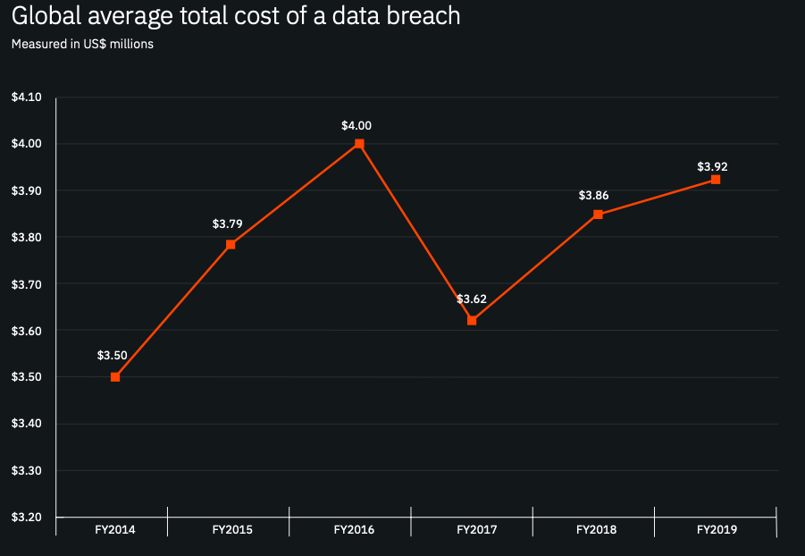

Slide 13
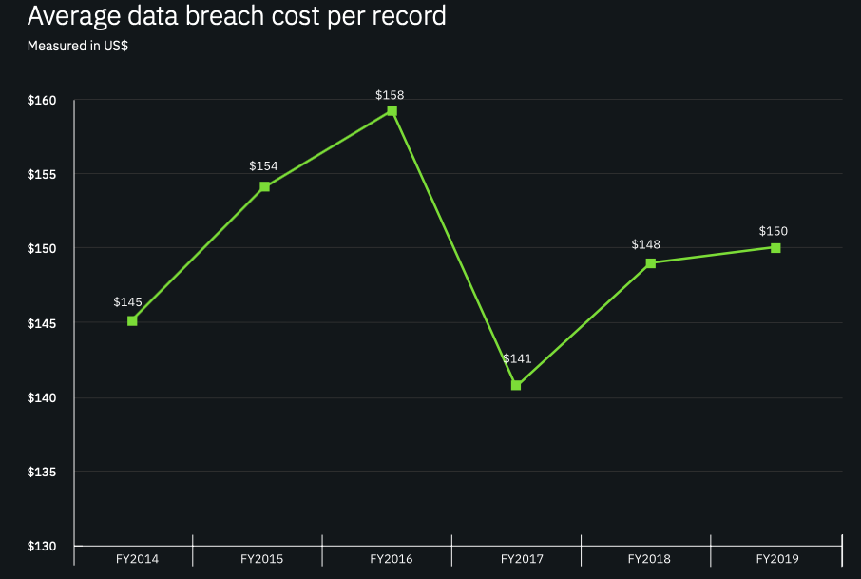

Slide 14
leakage of 20% of commercial information in 60 cases out of 100 leads to business loss
30% of all business losses caused by espionage
93% of companies with restricted access to their own information for more than 10 days loose business
in 2018 more than half (53%) of all attacks led to financial losses in excess of $ 500,000
to identify breach due to malicious attacks an average time of 256 days is needed; due to a human error - 158 days
Petya/NotPetya cyberattack caused a total loss of $1.2 billion (according to CiscoFebruary 2018, Annual Cybersecurity Report, Cisco Systems, 2018)

Slide 15
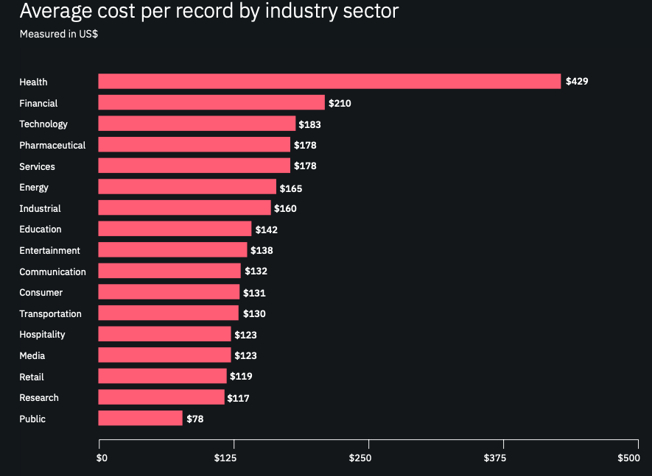

Slide 16
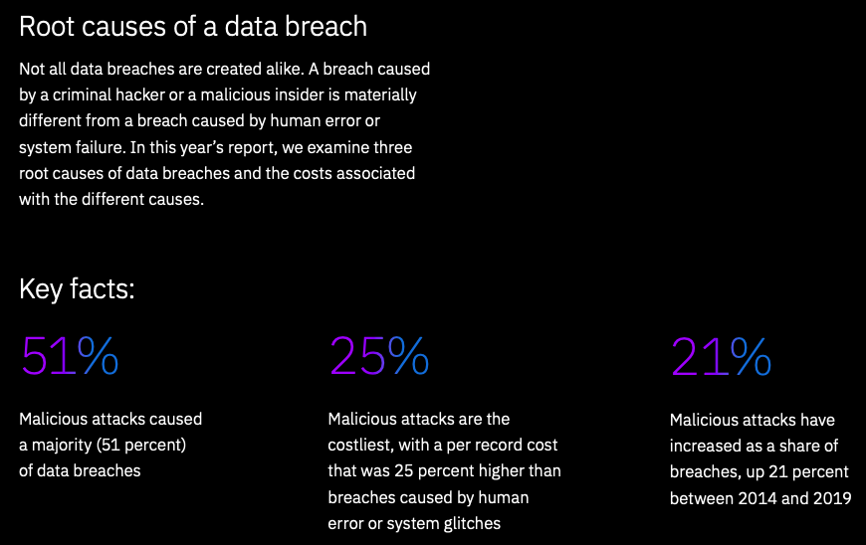

Slide 17
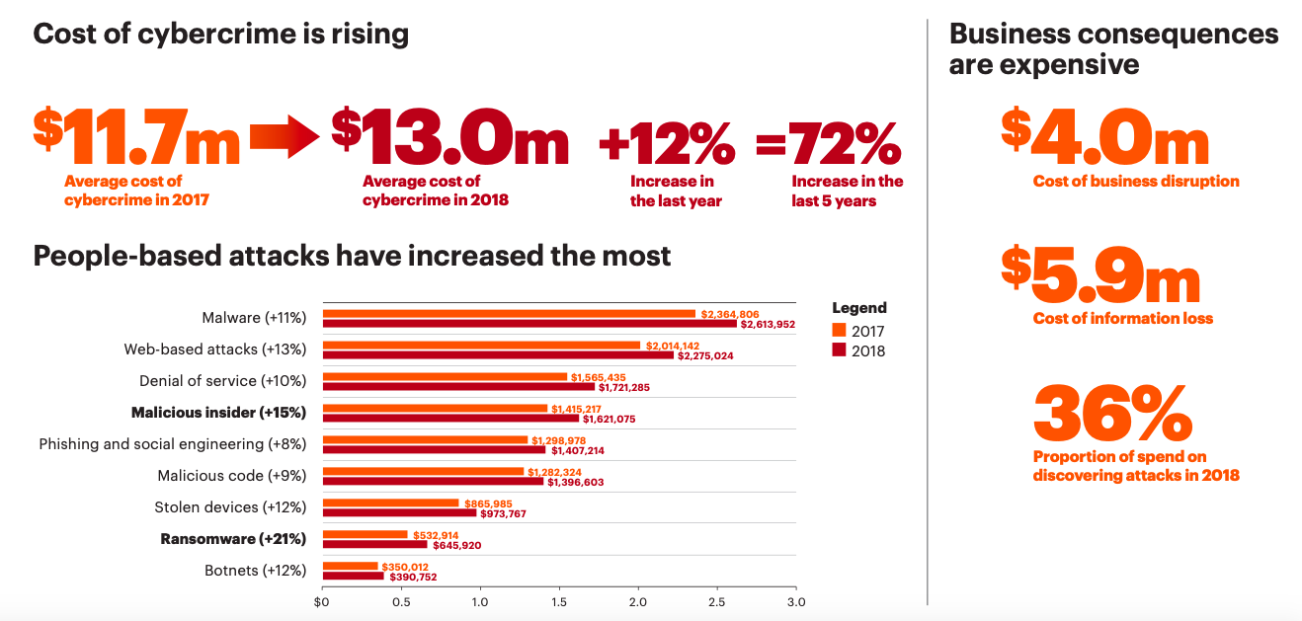

Slide 18
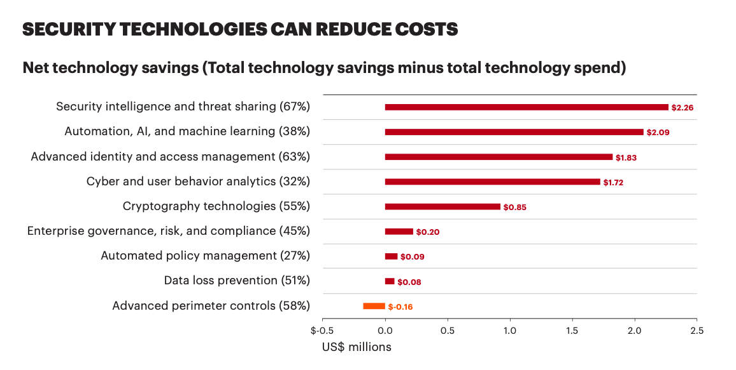

Slide 19
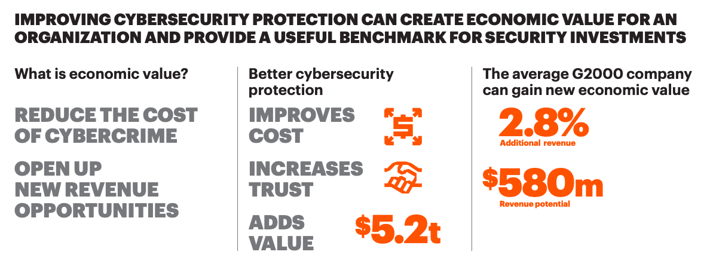

Slide 20
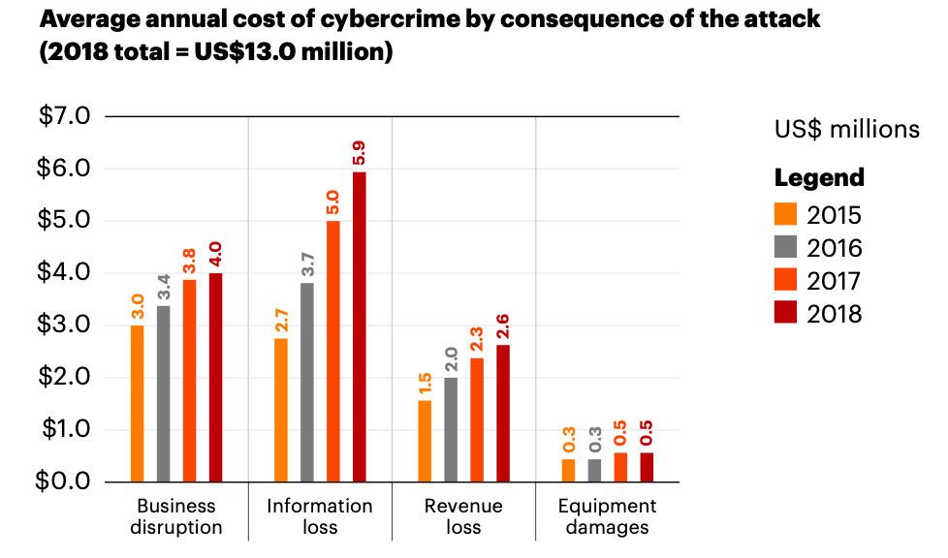

Slide 21
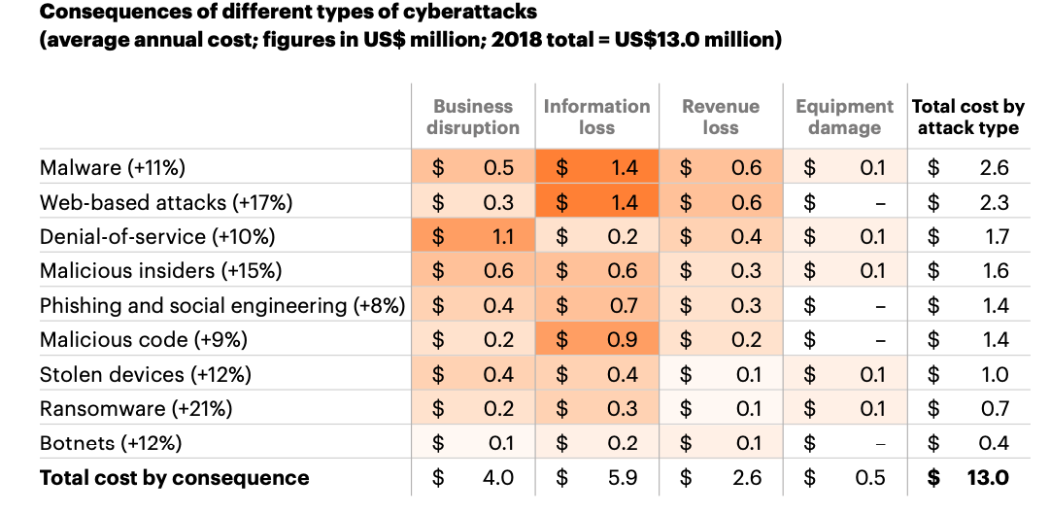

Slide 22
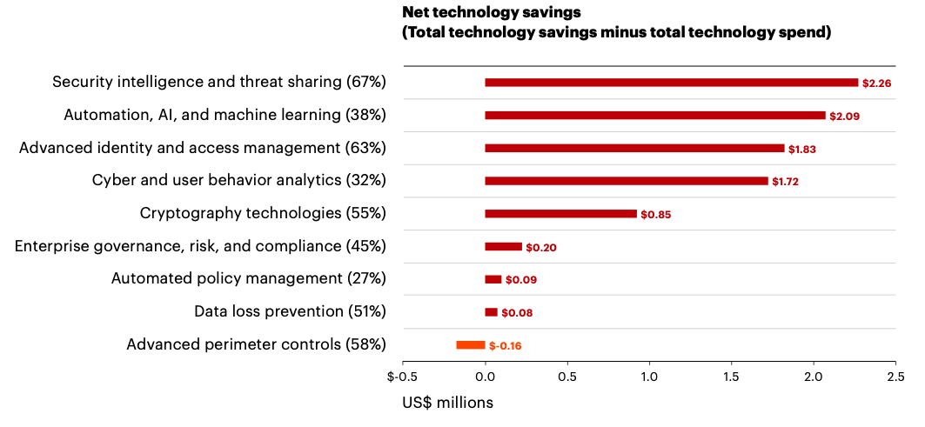

Slide 23
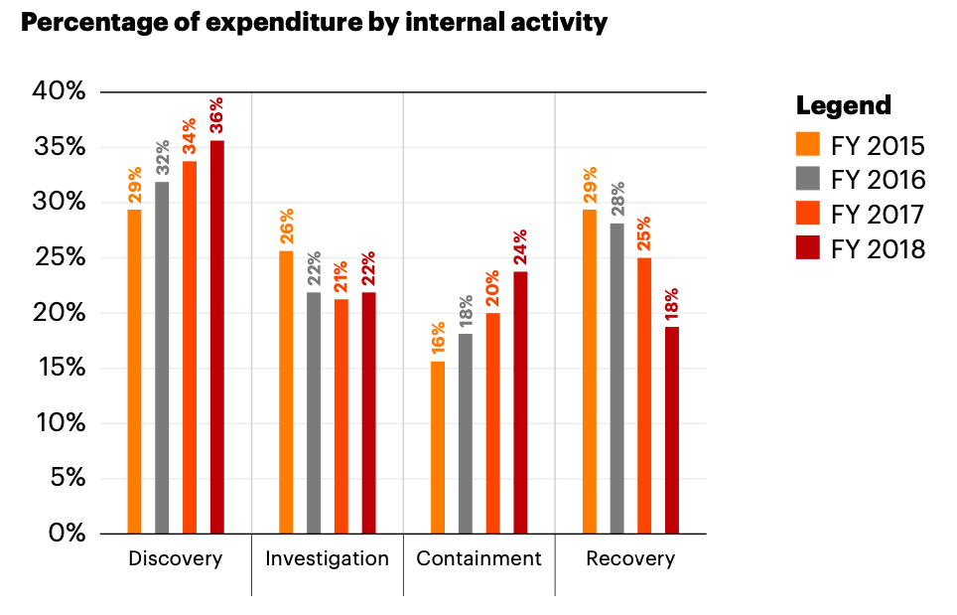

Slide 24
The key quantity in investment theory is the ratio of cost to benefit,
or in terms of a production function, the amount of output per unit of input.

Slide 25
security investment model (proposed by Gordon and Loeb) defines a security breach probability function, which maps the monetary value of security investment to a probability of incurring a defined loss

Slide 26
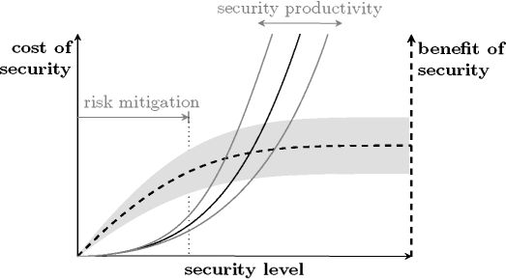
security production function is decomposed into two parts. First, the cost of security (in monetary terms) is mapped to the security level (solid lines in Fig.). Second, the security level stochastically determines the benefits of security (dashed lines and shaded area in Fig.)

Slide 27

Cost of Security
Cost of security seems to be the variable easiest to measure by summing up the expenses for the acquisition, deployment, and maintenance of security technology (direct cost)
Some security measures have non-negligible indirect cost, such as:
time lost due to forgotten credentials,
the inconvenience of transferring data between security zones,
incompatibilities of security mechanisms slowing down essential processes,
termination of payment transactions and other services,
legal fees,
PR

Slide 28
Types of costs
Onetime (acquisition and deployment of protection measures, license, consulting)
Recurring (maintenance, salary for IT security personnel, research)
Sunk or irreversible (expenses for training or for the distribution of security tokens to customers)

Slide 29
Cost components of a data breach
Lost business includes the abnormal turnover of customers, increased customer acquisition activities, reputation losses and diminished goodwill
The costs associated with ex-post response and detection include help communications, special investigative activities, remediation, legal expenditures, product discounts, identity protection services
Data breach costs associated with detection and escalation include forensic and investigative activities, assessment and audit services, crisis team management.
Notification-related include IT activities associated with the creation of contact databases, determination of all regulatory requirements, engagement of outside experts, postal expenditures, and communication set-up

Slide 30


Difficulty of calculating losses due to incidents
The level of security is determined by incidents that have been prevented
The security advantage depends to a large extent on the value of assets
The main questions are asked: "How much investment is enough?" And "Where to invest?”
Difficulty of measuring indirect costs of security
One security mechanism provides protection against many types of attacks, it is difficult to establish to what extent prevents each incident

Slide 31
The Annualised Loss Expectancy (ALE) from information security breaches is worked out empirically from the organisation’s experience and intelligence regarding intrusions, viruses, denial of service attacks and so on
ALE = SLE * ARO
SLE - Single Loss Exposure: estimated cost of the security incident
ARO - Annual Rate of Occurrence: probability of occurrence of incident

Slide 32

return on (security) investment (ROSI/ROI)
Expected Returns - Cost of Investment
ROI = -----------------------------------------------------
Cost of Investment
(Risk Exposure • % Risk Mitigated) - Solution Cost
ROSI = --------------------------------------------------------------------
Solution Cost

Slide 33
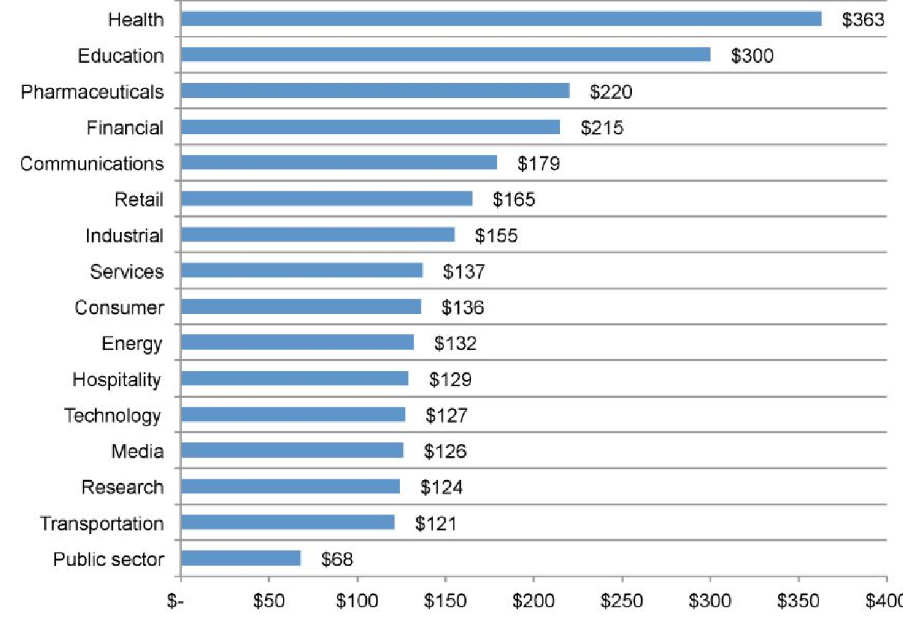
Losses due to security breaches by industry

Slide 34
Efficiency of investment decisions
The findings illustrate that many organizations may be spending too much on the wrong technologies
Security intelligence systems and advanced identity and access governance are the top best technologies
Innovations are generating the highest returns on investment (Cyber Analytics and User Behavior Analytics, Automation, orchestration and machine learning)

Slide 35
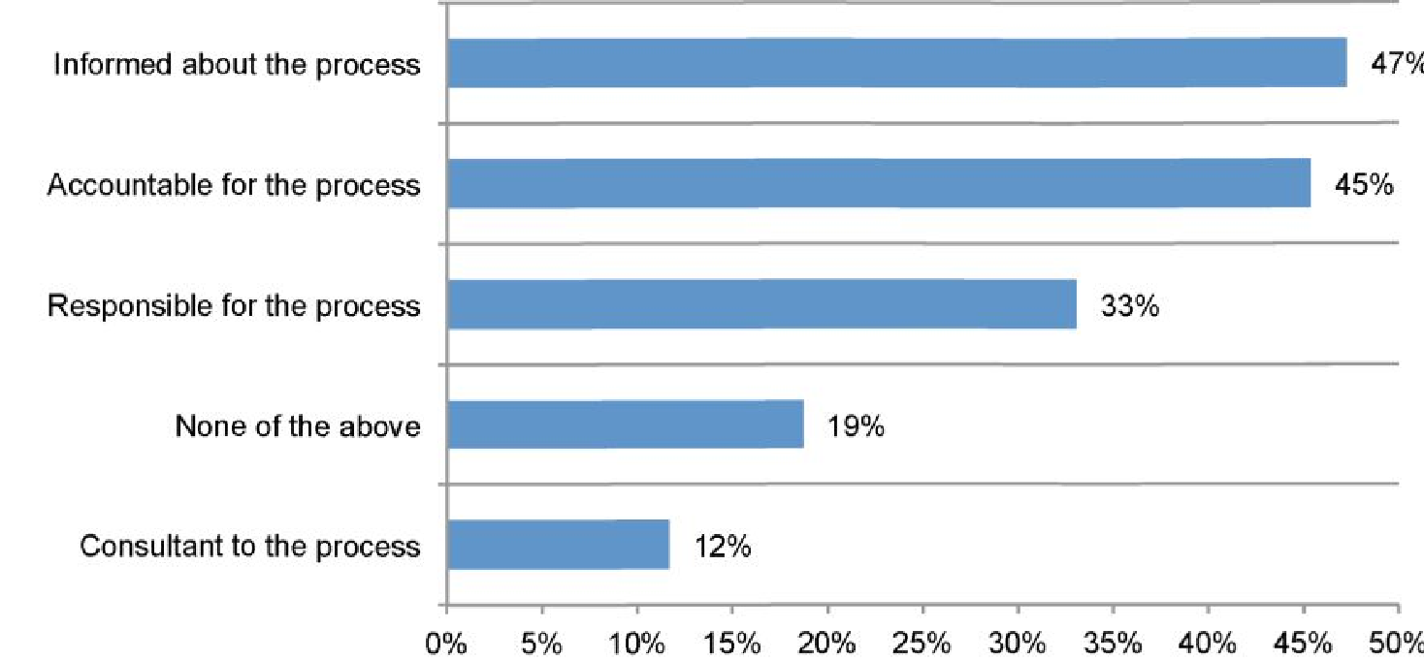
Level of knowledge about the incident response procedure

Slide 36
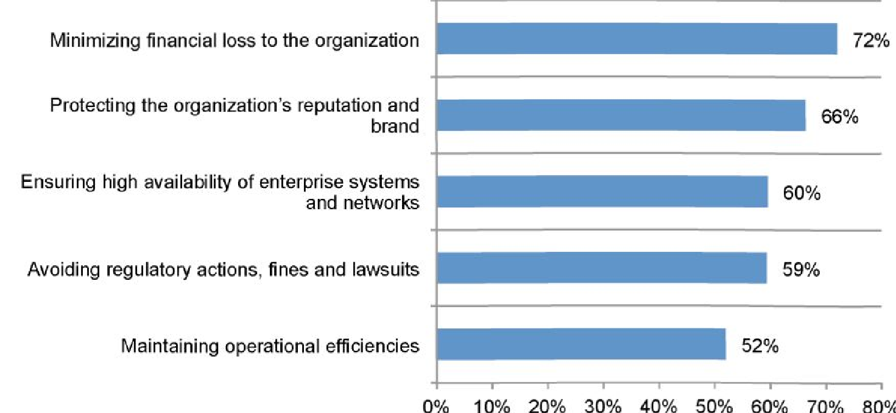
The main objectives of the incident response

Slide 37
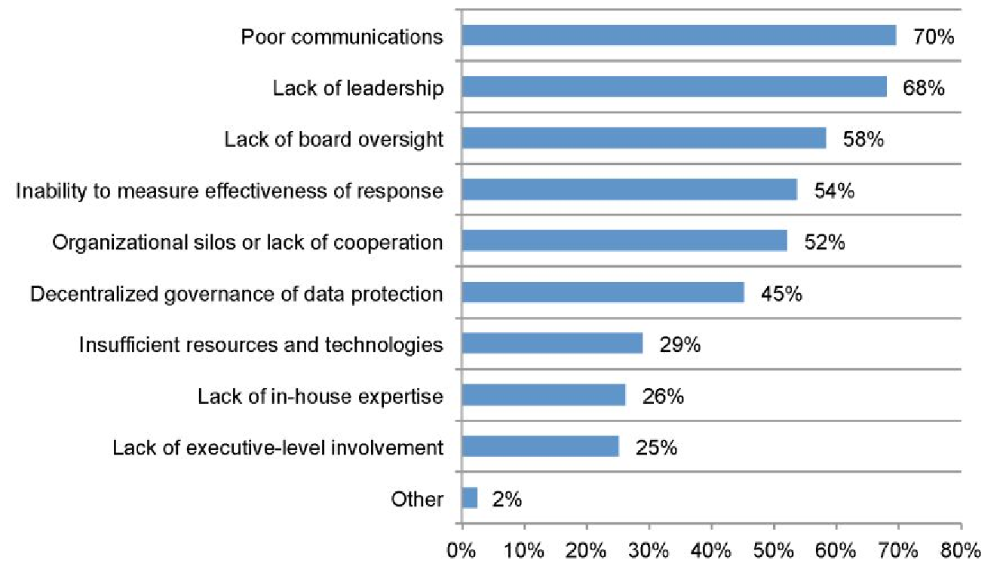
The main barriers to efficient incident management

Slide 38
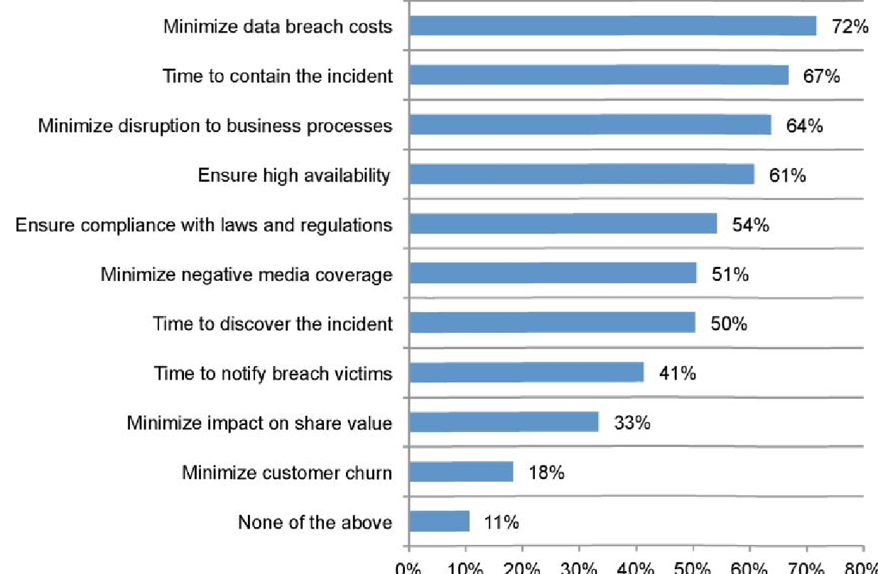
Criteria for assessing the effectiveness of incident management

Slide 39
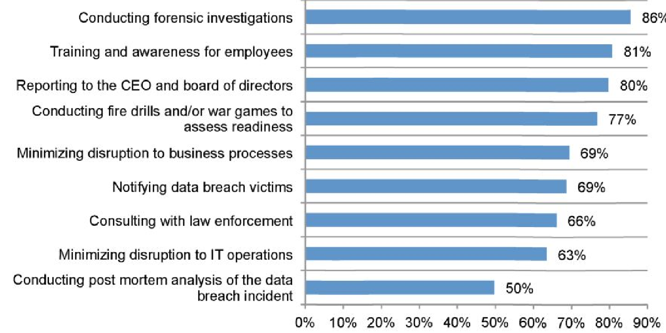
Key actions for efficient incident management

Slide 40
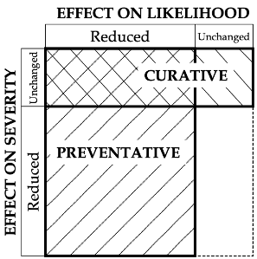
Security countermeasures

Slide 41
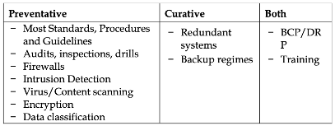
Security countermeasures

Slide 42
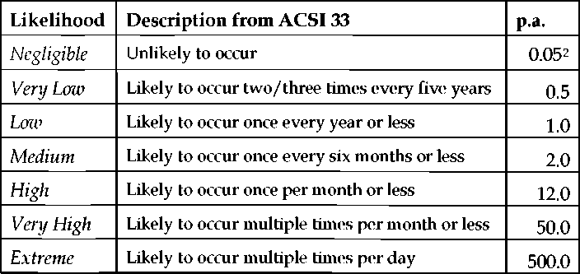
Probability of occurrence of incident

Slide 43
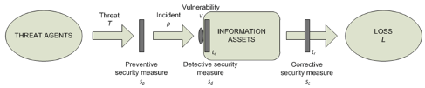
Integrating security measures

Slide 44
Typical activities for discovery and the immediate response to the data breach:
Conducting investigations and forensics to determine the root cause of the data breach
Determining the probable victims of the data breach
Organizing the incident response team
Conducting communication and public relations outreach
Preparing notice documents and other required disclosures to data breach victims and regulators
Implementing call center procedures and specialized training

Slide 45
activities conducted in the aftermath of discovering the data breach:
Audit and consulting services
Legal services for defense
Free or discounted services to victims of the breach
Identity protection services
Lost customer business based on calculating customer churn
Customer acquisition and loyalty program costs

Slide 46
Cost range for mentioned activities
• Direct cost - the direct expense outlay to accomplish a given activity.
• Indirect cost - the amount of time, effort and other organizational resources spent, but not as a direct cash outlay.
• Opportunity cost - the cost resulting from lost business opportunities as a consequence of negative reputation effects after the breach has been reported to victims (and publicly revealed to the media).

Slide 47
Expenditures associated with an organization’s data breach detection, response, containment and remediation:
Detection: Activities that enable a company to reasonably detect the breach of personal data either at risk or in motion.
Escalation: Activities necessary to report the breach of protected information to appropriate personnel within a specified time period.
Notification: Activities that enable the company to notify data subjects with a letter, telephone call, e-mail or general notice that personal information was lost or stolen.
Post data breach: Activities to help victims of a breach communicate with the company to ask additional questions or obtain recommendations in order to minimize potential harms.

Slide 48
Detection and escalation expenditures
— Forensic and investigative activities
— Assessment and audit services
— Crisis management
— Communications to executives and boards

Slide 49
Lost business expenditures
— Business disruption and revenue losses from system downtime
— Cost of lost customers and acquiring new customers
— Reputation losses and diminished goodwill

Slide 50
Notification expenditures
— Emails, letters, outbound calls or general notice to data subjects
— Determination of regulatory requirements
— Communication with regulators
— Engagement of outside experts

Slide 51
Post-response expenditures
— Help desk and inbound communications
— Credit monitoring and identity protection services
— Issuing new accounts or credit cards
— Legal expenditures
— Product discounts
— Regulatory fines

Slide 52
References
L. A. Gordon and M. P. Loeb. The economics of information security investment. ACM Trans. Inf. Syst. Secur., 5(4):438–457, 2002.
Security Attribute Evaluation Method: A Cost-Benefit Approach Shawn A. Butler, Computer Science Department, Carnegie Mellon University, 2002.
Cost-Benefit Analysis for Network Intrusion Detection Systems Huaqiang Wei, Deborah Frinke et al. Centre for Secure and Dependable Software, University of Idaho. In Proceedings of the 28th Annual Computer Security Conference October 2001.
2019 Cost of a Data Breach Report, Ponemon Institute, IBM Security
2019 The Cost of Cybercrime, Accenture Security

